Slide 1

Computer Science and Engineering
TY BTech Trimester-VII
Disclaimer:
Information included in these slides came from multiple sources. We have tried our best to cite the sources. Please refer to the references to learn about the sources, when applicable.
The slides should be used only for preparing notes, academic purposes (e.g. in teaching a class), and should not be used for commercial purposes.

Slide 2
Unit 2: NETWORK LAYER
Network Layer Design Issues
Switching Techniques
Protocol: IPv4 and IPv6 addressing schemes

Slide 3
Functionality of Network Layer
Implements routing of frames (packets) through the network.
Defines the most optimum path the packet should take from the source to the destination.
Defines logical addressing so that any endpoint can be identified.
Handles congestion in the network.
Facilitates interconnection between heterogeneous networks (Internetworking).
The network layer also defines how to fragment a packet into smaller packets to accommodate different media

Slide 4
Network Layer Design Issues
Store-and-Forward Packet Switching
Services Provided to the Transport Layer
Implementation of Connectionless Service
Implementation of Connection-Oriented Service
Virtual-Circuit and Datagram Subnets

Slide 5
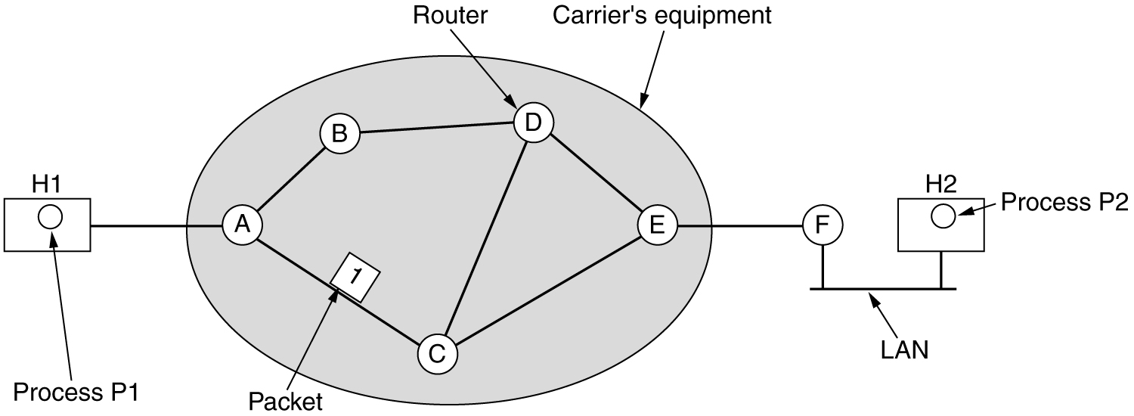
Store-and-Forward Packet Switching
Environment of network layer protocols

Slide 6
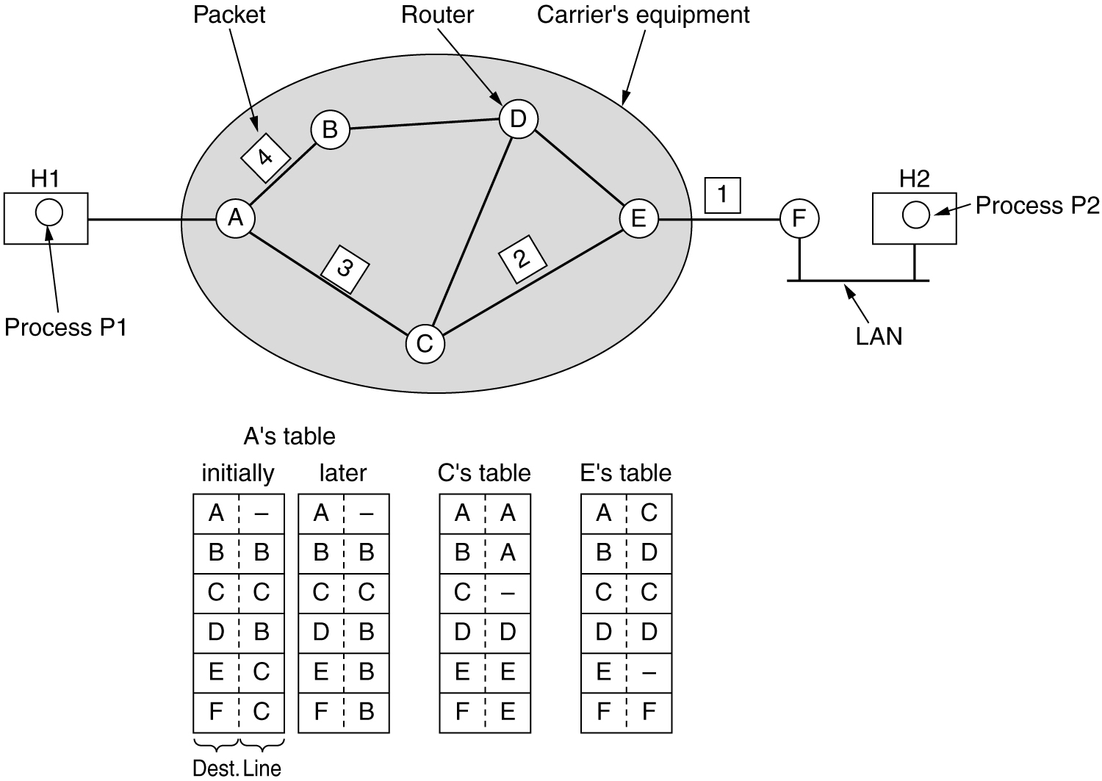
Implementation of Connectionless Service
Routing within a diagram subnet

Slide 7
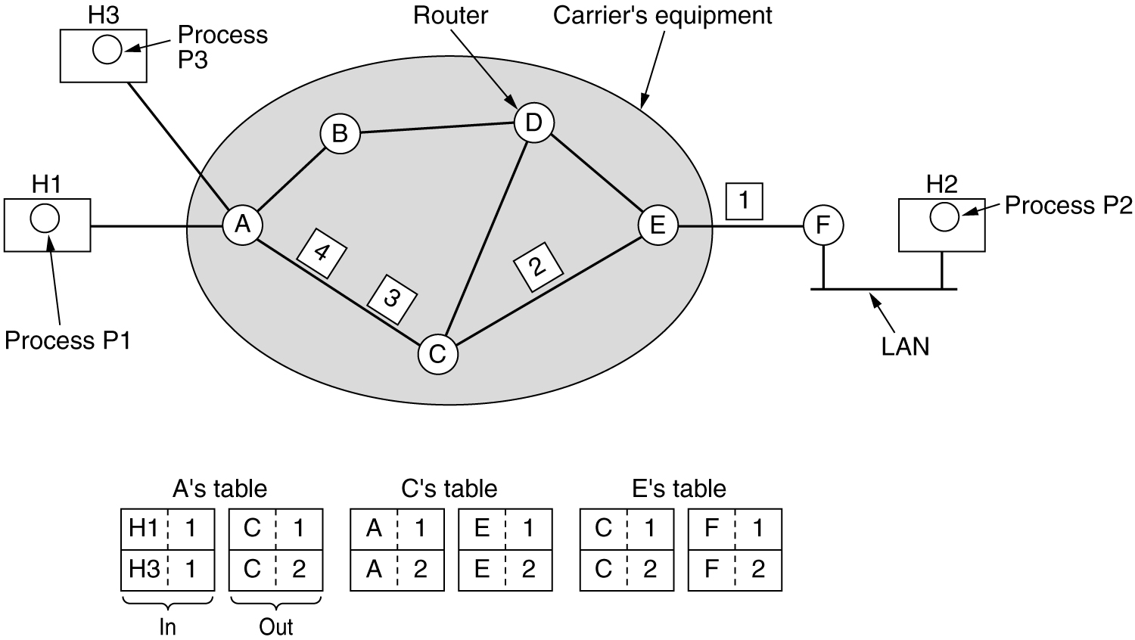
Implementation of Connection-Oriented Service
Routing within a virtual-circuit subnet

Slide 8
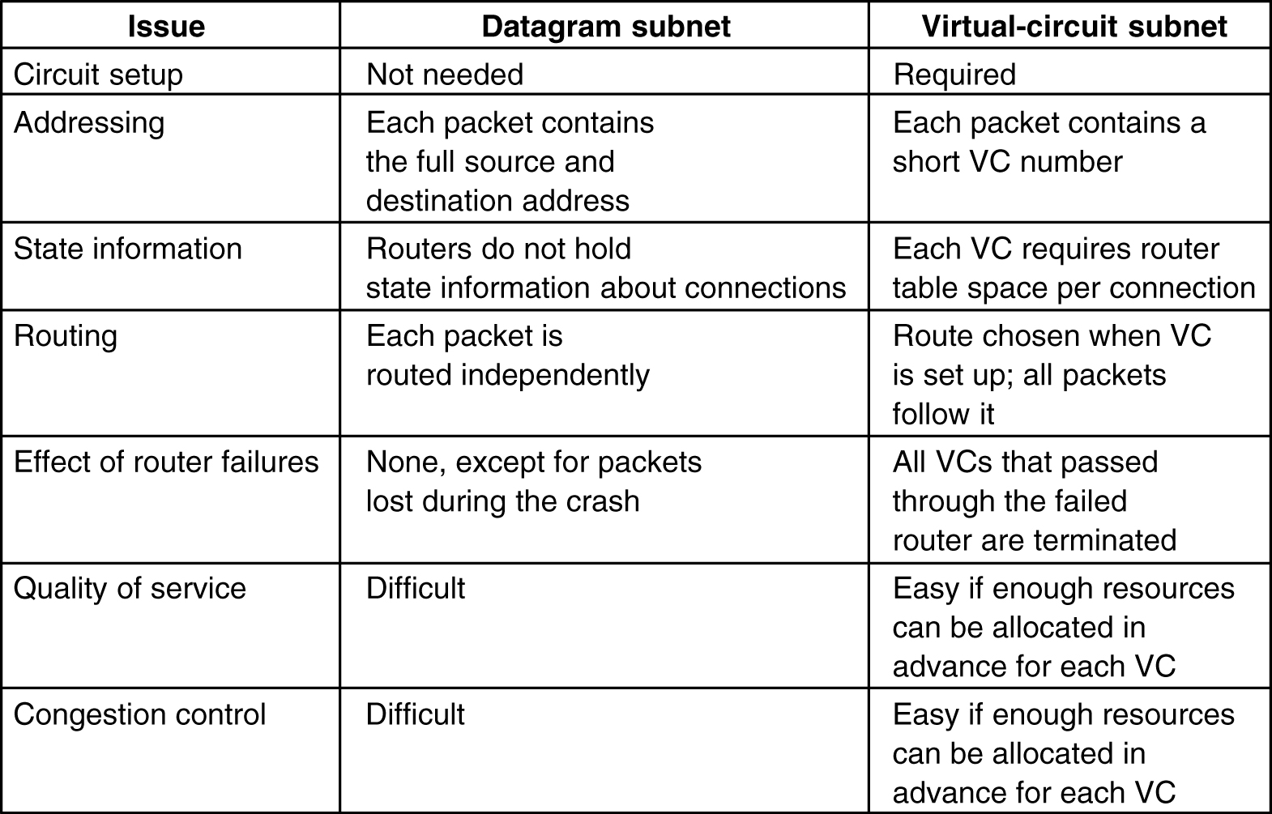
Comparison of Virtual-Circuit and Datagram Subnets
5-4

Slide 9
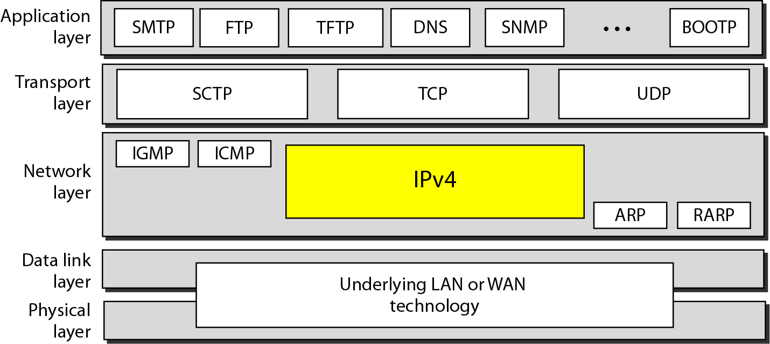
Position of IPv4 in TCP/IP protocol suite

Slide 10
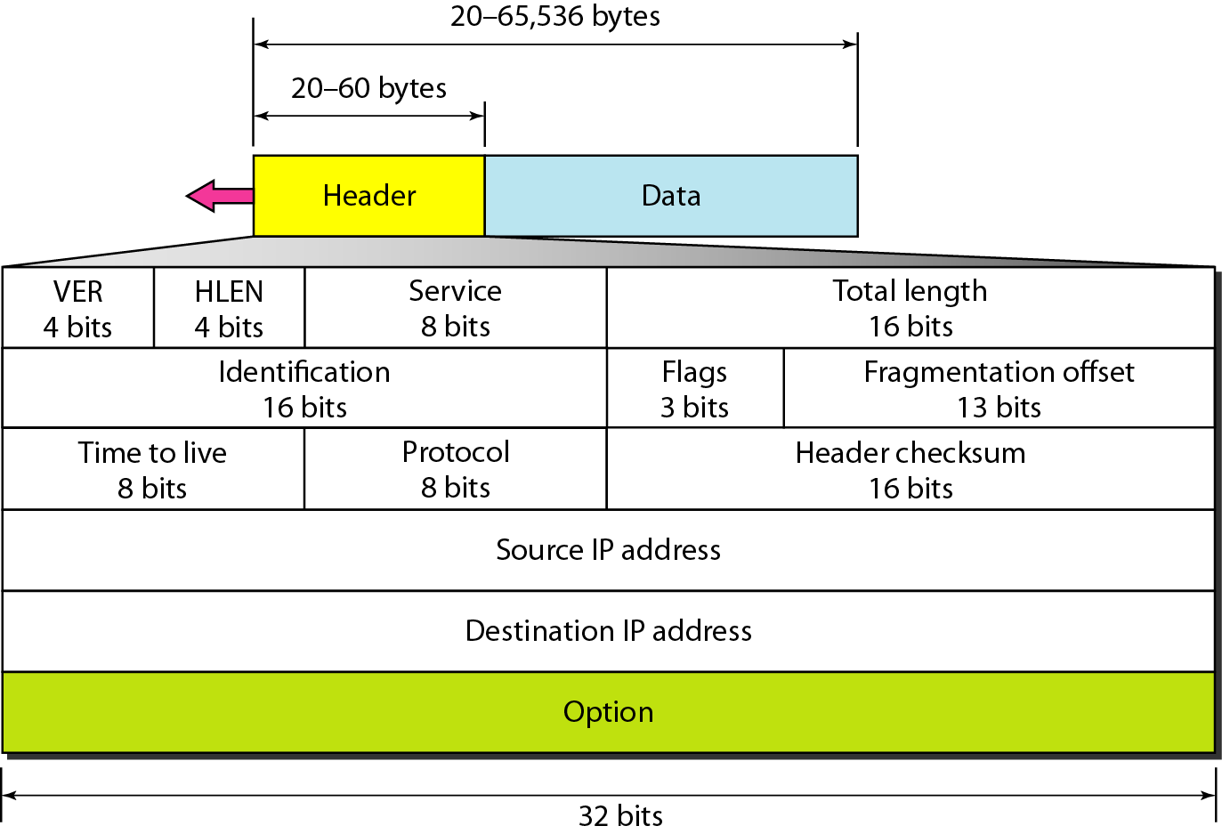
Internet Protocol: IPv4

Slide 11
IPv4 Datagram Format
Version (VER): version of the IP protocol. Currently, the version is 4.
Header length (HLEN): the total length of the datagram header in 4-byte words.
Services: service type or differentiated services (not used now).
Total length: total length (header plus data) of the datagram in bytes.
Total length of data = total length – header length

Slide 12
IPv4 Datagram Format
Identification: used in fragmentation
Flags: used in fragmentation
Fragmentation offset: used in fragmentation
Time to live: it is used to control the maximum number hops visited by the datagram.
Protocol: defines the higher-level protocol that uses the services of the IPV4 layer.

Slide 13
IPv4 Datagram Format
Checksum: 1’s compliment checksum
Source address: is the IPv4 address of the source.
Destination address: is the IPv4 address of the source.

Slide 14
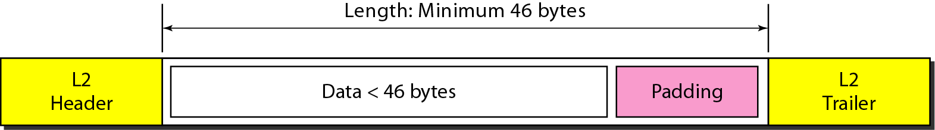
Encapsulation of a small datagram in an Ethernet frame
One of the reason why “total length”
field is required.

Slide 15
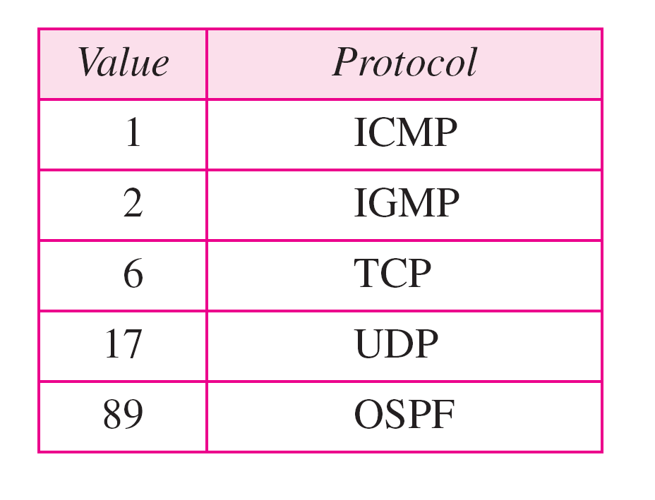
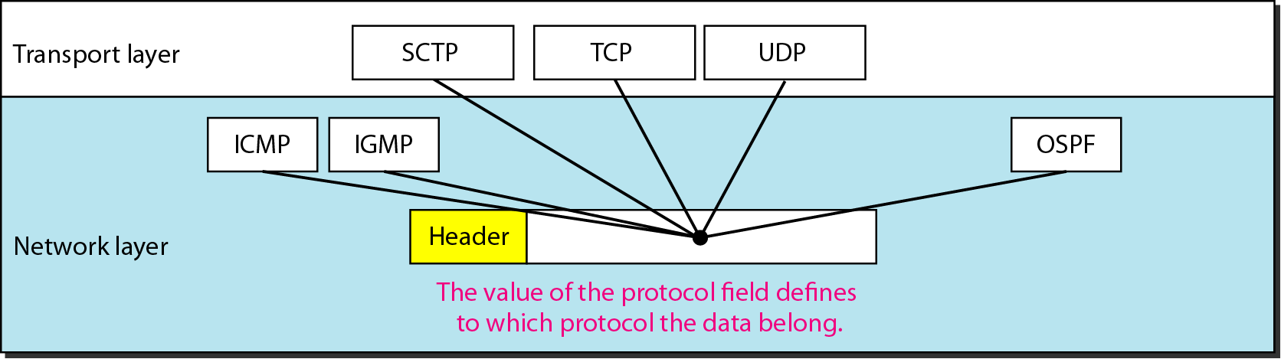
Protocol field and encapsulated data
Protocol values

Slide 16
Example
An IPv4 packet has arrived with the first 8 bits as shown:
01000010
The receiver discards the packet. Why?
Solution
There is an error in this packet. The 4 leftmost bits (0100) show the version, which is correct. The next 4 bits (0010) show an invalid header length (2 × 4 = 8). The minimum number of bytes in the header must be 20. The packet has been corrupted in transmission.

Slide 17
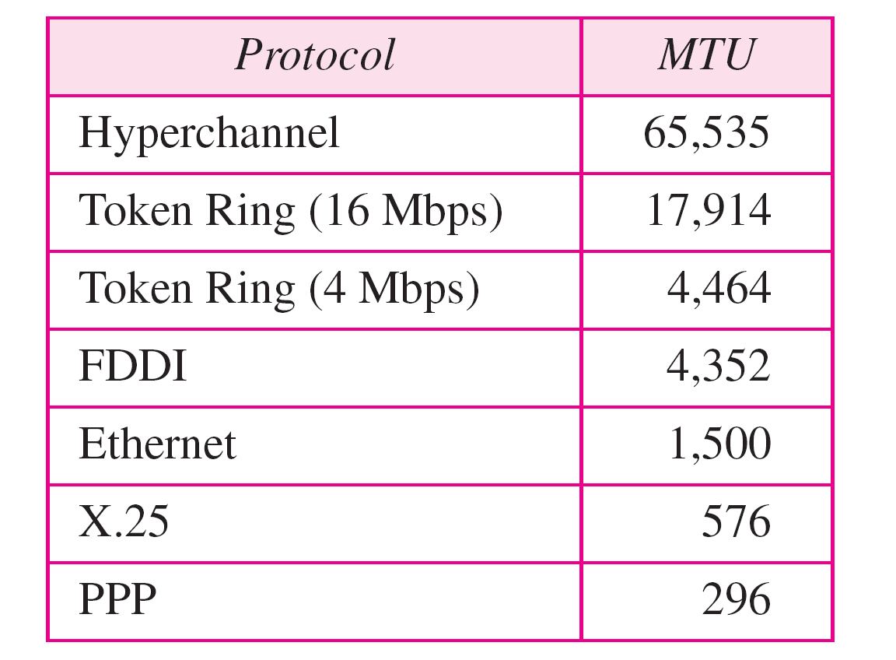
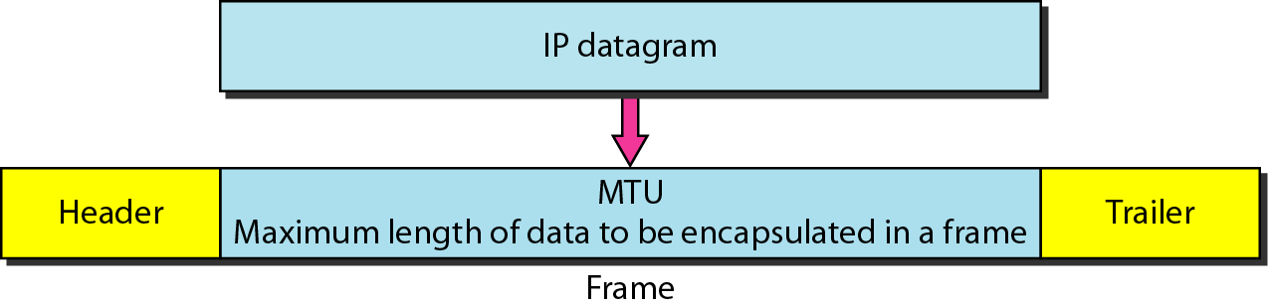
Maximum transfer unit (MTU)
MTUs for some networks

Slide 18
Fields Related to Fragmentation
Identification: identifies a datagram originating from the source host. A combination of the identification and source address must uniquely define a datagram as it leaves the source node.
Flags: see next slide.
Fragmentation offset: is the offset of the data in the original datagram measured in units of 8 bytes.

Slide 19
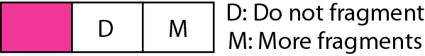
Figure 20.10 Flags (3 bits) used in fragmentation
first bit: reserved (not used)
second bit: = 1 requires the packet not to be fragmented
drops the packet if it is > MTU
third bit: =1 more fragmented packets later
=0 the last fragmented packet

Slide 20
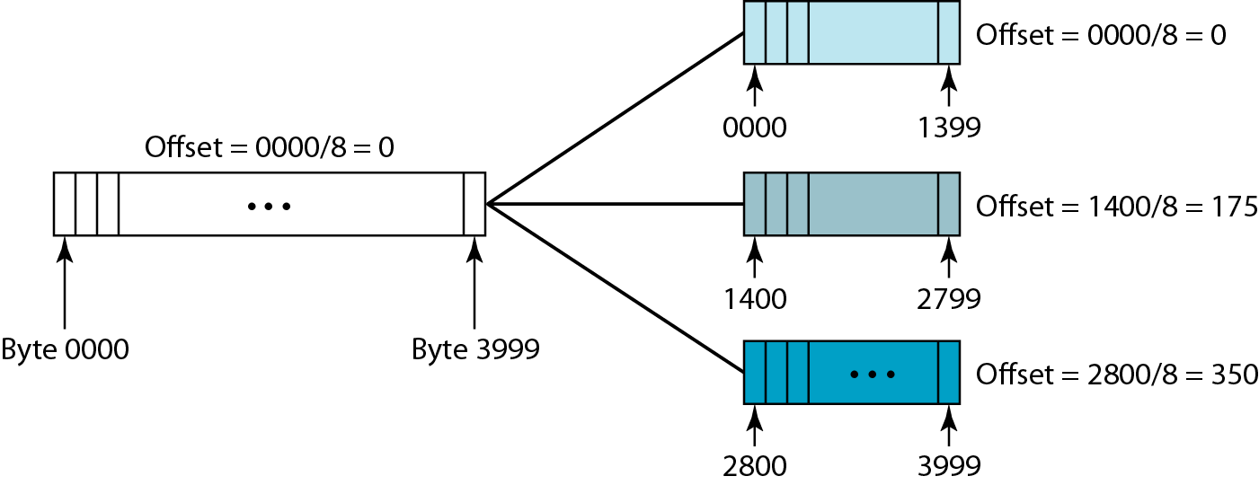
Figure 20.11 Fragmentation example

Slide 21
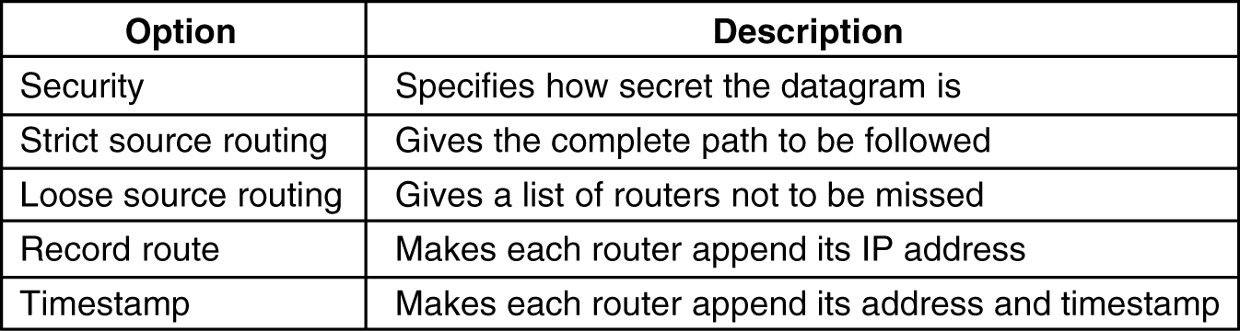
Internet Protocol: IPv4
5-54

Slide 22
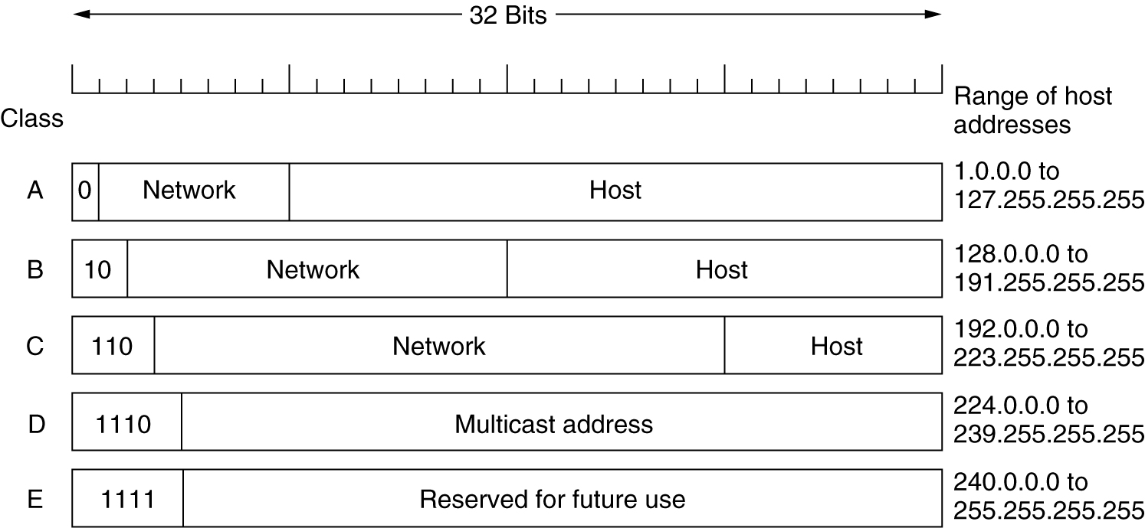
IP Addresses
IP address formats.

Slide 23
Classful Addressing
“Class A” Address:
-The first bit of the first octet is always set to 0 (zero). Thus the first octet ranges from 1 –127, i.e.
-Class A addresses only include IP starting from 1.x.x.x to 126.x.x.x only. The IP range 127.x.x.x is reserved for loopback IP addresses.
-The default subnet mask for Class A IP address is 255.0.0.0 which implies that Class A addressing can have 126 networks and 16777214 hosts .
-Class A IP address format is thus:
0NNNNNNN.HHHHHHHH.HHHHHHHH.HHHHHHHH

Slide 24
Classful Addressing
“Class B” Address:
-An IP address which belongs to class B has the first two bits in the first octet set to 10, i.e.
-Class B IP Addresses range from 128.0.x.x to 191.255.x.x. The default subnet mask for Class B is 255.255.x.x.
-Class B has 16384 (214) Network addresses and 65534 (216-2) Host addresses.
-Class B IP address format is thus:
10NNNNNN.NNNNNNNN.HHHHHHHH.HHHHHHHH

Slide 25
Classful Addressing
“Class C” Address:
-The first octet of Class C IP address has its first 3 bits set to 110, that is:
-Class C IP addresses range from 192.0.0.x to 223.255.255.x. The default subnet mask for Class C is 255.255.255.x.
-Class C gives 2097152 (221) Network addresses and 254 (28-2) Host addresses.
-Class C IP address format is thus:
110NNNNN.NNNNNNNN.NNNNNNNN.HHHHHHHH

Slide 26
Classful Addressing
“Class D” Address:
-Very first four bits of the first octet in Class D IP addresses are set to 1110, giving a range of:
11100000-11101111
224-239
-Class D has IP address rage from 224.0.0.0 to 239.255.255.255.
-Class D is reserved for Multicasting. In multicasting data is not destined for a particular host, that is why there is no need to extract host address from the IP address, and Class D does not have any subnet mask.

Slide 27
Classful Addressing
“Class E” Address:
-This IP Class is reserved for experimental purposes only for R&D or Study.
11110000-11111111
240-255
-IP addresses in this class ranges from 240.0.0.0 to 255.255.255.254.
-Like Class D, this class too is not equipped with any subnet mask.

Slide 28
Given the network address 17.0.0.0, find the class, the block, and the range of the addresses.
Solution
The class is A because the first byte is between 0 and 127.
The block has a netid of 17.
The addresses range from 17.0.0.0 to 17.255.255.255.

Slide 29
Given the network address 132.21.0.0, find the class, the block, and the range of the addresses.
Solution
The class is B because the first byte is between 128 and 191.
The block has a netid of 132.21. The addresses range from
132.21.0.0 to 132.21.255.255.

Slide 30
Given the network address 220.34.76.0,find the class, the block, and the range of the addresses.
Solution
The class is C because the first byte is between 192 and 223.
The block has a netid of 220.34.76.
The addresses range from 220.34.76.0 to 220.34.76.255.

Slide 31
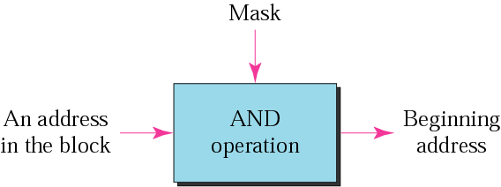
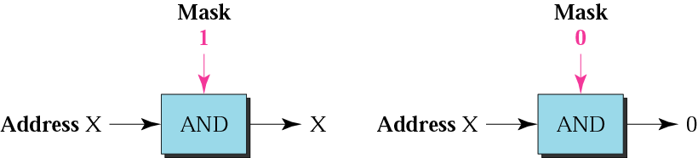
A mask is a 32-bit binary number that gives the first address in the block (the network address) when bitwise ANDed with an address in the block.
And Operation

Slide 32
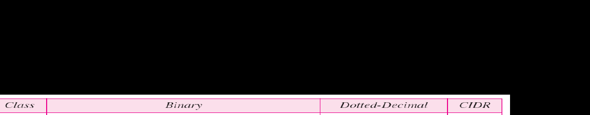
-CIDR –Classless Inter Domain Routing
-Default Masks used

Slide 33
A block of addresses is granted to a small organization. We know that one of the addresses is 205.16.37.39/28. What is the first address in the block?
Solution
The binary representation of the given address is
11001101 00010000 00100101 00100111
Mask is 11111111 11111111 11111111 11110000
If we set 32−28 rightmost bits to 0, we get
11001101 00010000 00100101 0010000
or 205.16.37.32.

Slide 34
What is the network address if one of the addresses is 167.199.170.82/27?
Solution
The prefix length is 27,which means that we must keep the first 27bits as 1s and change the remaining bits(5)to0s.The 5 bits affect only the last byte. The last byte is 01010010.Changing the last 5 bits to 0s,we get 01000000 or 64.The network address is 167.199.170.64/27.

Slide 35
A small organization is given a block with the beginning address and the prefix length 205.16.37.24/29(in slash notation).What is the range of the block?
Solution
The beginning address is 205.16.37.24.To find the last address we keep the first 29 bits and change the last 3 bits to1s.
Beginning:11001111 00010000 00100101 00011000
Ending : 11001111 00010000 00100101 00011111
There are only 8 addresses in this block.

Slide 36
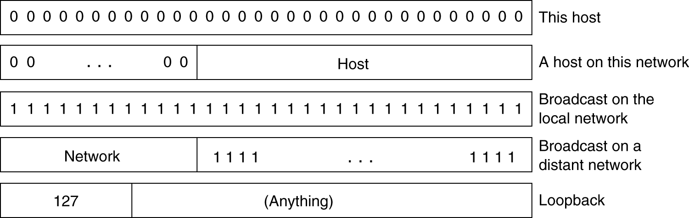
Special IP Addresses

Slide 37
Internet Protocol: IPv6
Initial motivation:
32-bit address space soon to be completely allocated
Additional motivation:
header format helps speed processing/forwarding
header changes to facilitate QoS
IPv6 datagram format:
Fixed length 40-byte header
fragmentation not allowed

Slide 38
IP Version 6 Goals
Support billions of hosts
Reduce routing table size
Simplify protocol
Better security
Attention to type of service
Aid multicasting
Roaming host without changing address
Allow future protocol evolution
Permit coexistence of old, new protocols. . .

Slide 39
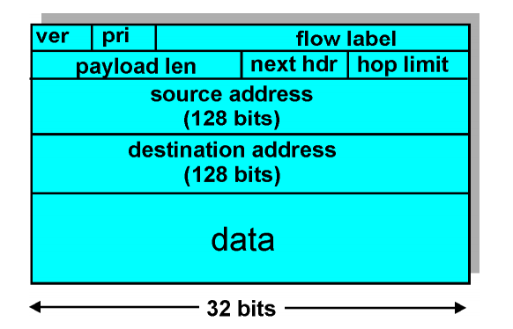
Internet Protocol: IPv6
Priority: identify priority among datagrams
Flow Label: identify datagrams in same ‘flow’
Next Header: identify upper layer protocol for data

Slide 40
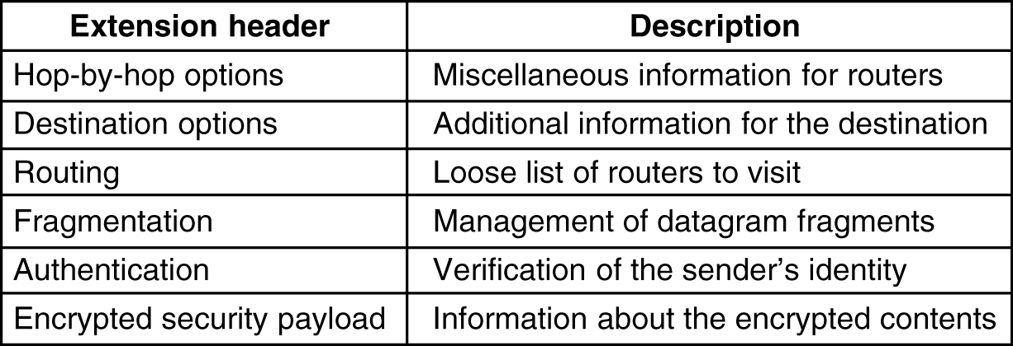
IPv6 Extension Headers
5-69

Slide 41
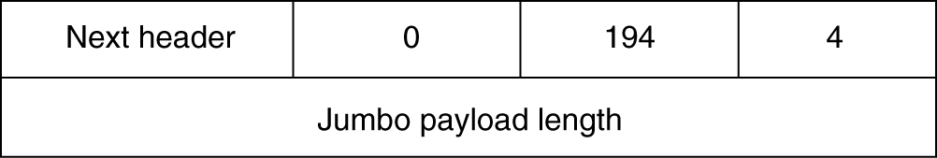
IPv6 Extension Headers
Hop-by-hop extension header for large datagrams (jumbograms)

Slide 42
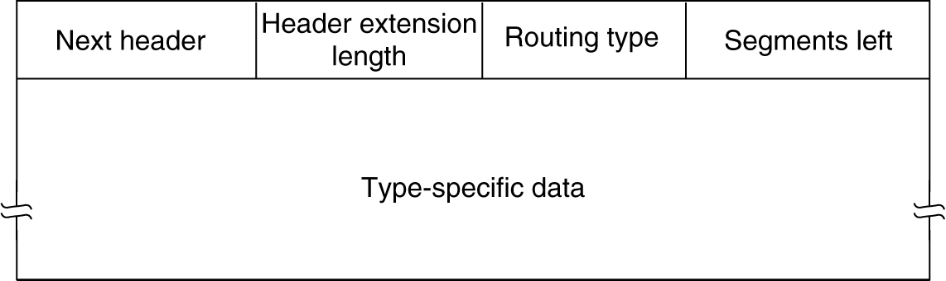
IPv6 Extension Headers (Routing)

Slide 43
Unit 2: NETWORK LAYER
Sub netting
Classless Inter-Domain Routing (CIDR)
Network Address Translation (NAT)
Internet Control Message Protocol (ICMP)

Slide 44
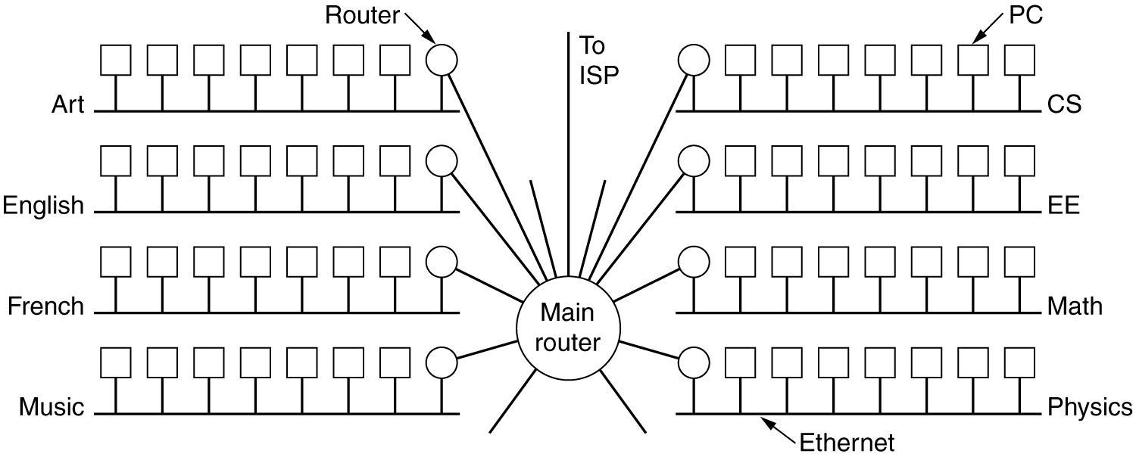
Subnets
LAN: Campus network for various departments

Slide 45
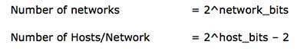
The number of networks and the number of hosts per class can be derived by this formula:
-When calculating hosts' IP addresses, 2 IP addresses are decreased because they cannot be assigned to hosts, i.e. the first IP of a network is network number and the last IP is reserved for Broadcast IP.

Slide 46
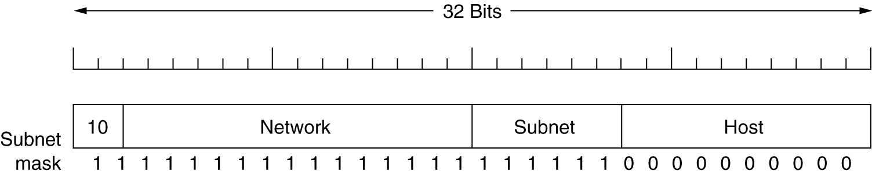
Subnets cont..
Class B network: 64 subnets

Slide 47
Classful Addressing (Cntd.)
A company is granted the site address 201.70.64.0 (class C). The company needs six subnets. Design the subnets.
Solution
The number of 1s in the default mask is 24 (class C).

Slide 48
The company needs six subnets. This number 6 is not a power of 2.The next number that is a power of 2 is 8(23).We need 3 more 1s in the sub netmask. The total number of 1s in the subnet mask is 27(24+3).
The total number of 0s is5(32-27).The mask is
11111111 11111111 11111111 11100000
or
255.255.255.224
The number of subnets is 8.
The number of addresses in each subnet is2^5(5is the number of 0s)or32.

Slide 49
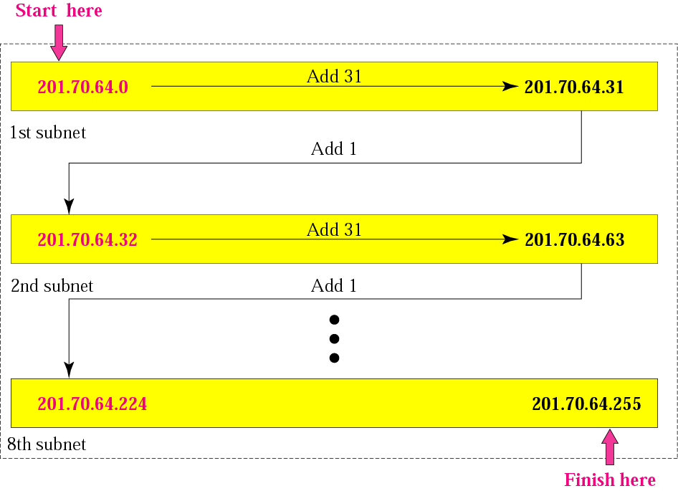

Slide 50
An organization is granted the block 130.34.12.64/26.The organization needs to have four subnets. What are the subnet addresses and the range of addresses for each subnet?
Solution
The suffix length is 6.This means the total number of addresses in the block is 64(26).If we create four subnets, each subnet will have 16 addresses.

Slide 51
Let us first find the subnet prefix (subnetmask). We need four subnets, which means we need to add two more 1s to the site prefix. The subnet prefix is then/28.
Subnet1:130.34.12.64/28 to 130.34.12.79/28.
Subnet2:130.34.12.80/28 to 130.34.12.95/28.
Subnet3:130.34.12.96/28 to 130.34.12.111/28.
Subnet4:130.34.12.112/28 to1 30.34.12.127/28.

Slide 52
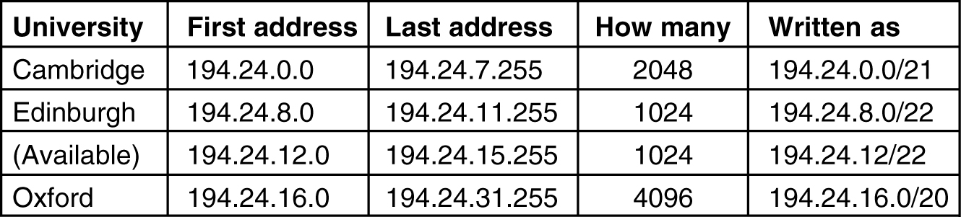
CIDR – Classless InterDomain Routing
IP address assignments
5-59

Slide 53
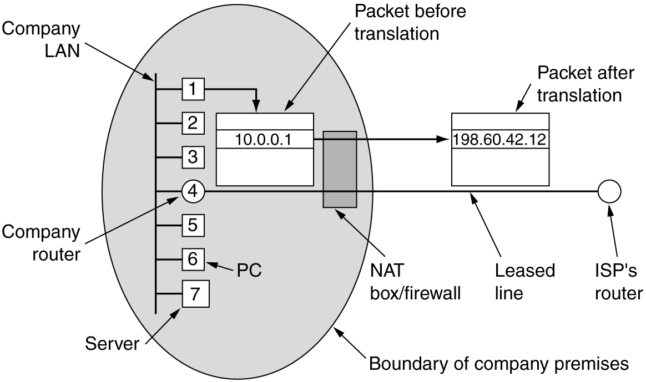
NAT – Network Address Translation
NAT: Placement and operation

Slide 54
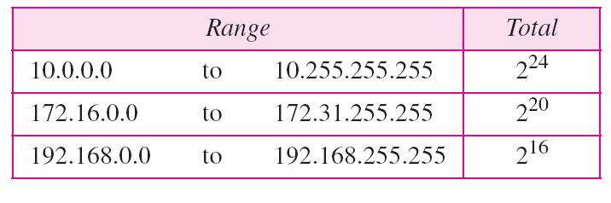
Addresses for private networks

Slide 55
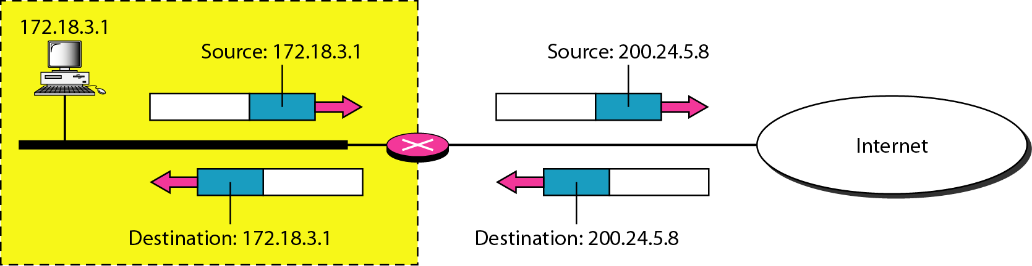
Addresses in a NAT

Slide 56
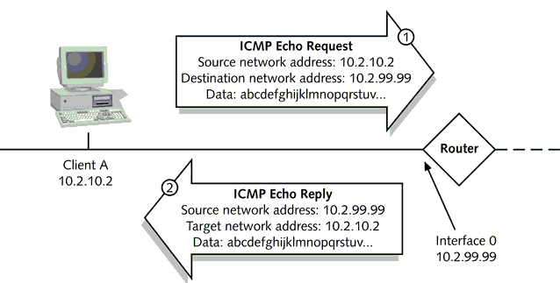
Internet Control Message Protocols
ICMP’s most common uses are testing and troubleshooting.
Two of the most well-known utilities, PING and TRACEROUTE, rely on ICMP to perform connectivity tests and path discovery.

Slide 57
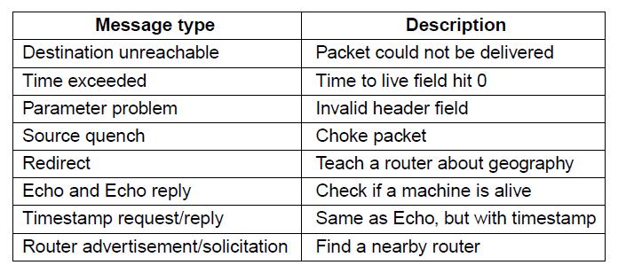
Internet Control Message Protocols
The principal ICMP message types.

Slide 58
Routing Algorithm
Network Layer responsible for deciding on which output line to transmit an incoming packet.
For virtual circuit subnets:
routing decision is made ONLY at set up
Algorithm properties:
correctness, simplicity, robustness, stability, fairness, optimality and scalability

Slide 59
Internetwork Routing
Routing Classification
Adaptive Routing
based on current measurements
of traffic and/or topology.
Non-Adaptive Routing
routing computed in advance and off-line

Slide 60
Internetwork Routing
Adaptive Routing
Centralized
Distributed
Isolated
[IGP]
Intradomain routing
[EGP]
Interdomain routing
Interior
Gateway Protocols
[BGP,IDRP]
Exterior
Gateway Protocols
Distance Vector routing
Link State routing
[RIP]
[OSPF,IS-IS,PNNI]

Slide 61
Internetwork Routing
Non - Adaptive Routing
flooding
Static Routing
Pure flooding
Selective flooding

Slide 62
Flooding
Pure flooding :: every incoming packet to a node is sent out on every outgoing line.
Obvious adjustment – do not send out on arriving link (assuming full-duplex links).
The routing algorithm can use a hop counter (e.g., TTL) to dampen the flooding.
Selective flooding :: only send on those lines going “approximately” in the right direction.

Slide 63
Shortest-Path Routing
Problem: Given a graph, where nodes represent routers and edges, links, find shortest path between a given pair of nodes.
What is shortest in shortest path?
Depends on the routing metric in use.
Example: number of hops (static), geographic distance (static), delay, bandwidth (raw versus available), combination of a subset of these.
Dijkstra’s shortest-path algorithm (19590).
Initially, links are assigned costs.
As the algorithm executes, nodes are labeled with its distance to source along best known path.
Initially, no routes known, so all nodes are labeled with infinity.
Labels change as the algorithm proceeds.
Labels can be temporary or permanent.
-- Initially all labels are tentative.
-- A label becomes permanent if it represents the shortest path from the source to the node.

Slide 64
Shortest Path Search
Dijkstra’s Algorithm
1. Start with the local node (router): the root of the tree.
2. Assign a cost of 0 to this node and make it the first permanent node.
3. Examine each neighbour node of the node that was the last permanent node.
4. Assign a cumulative cost to each node and make it tentative.
5. Among the list of tentative nodes a. Find the node with the smallest cumulative cost and make it permanent.
b. If a node can be reached from more than one direction
i. Select the direction with the shortest cumulative cost.
6. Repeat steps 3 to 5 until every node becomes permanent.

Slide 65
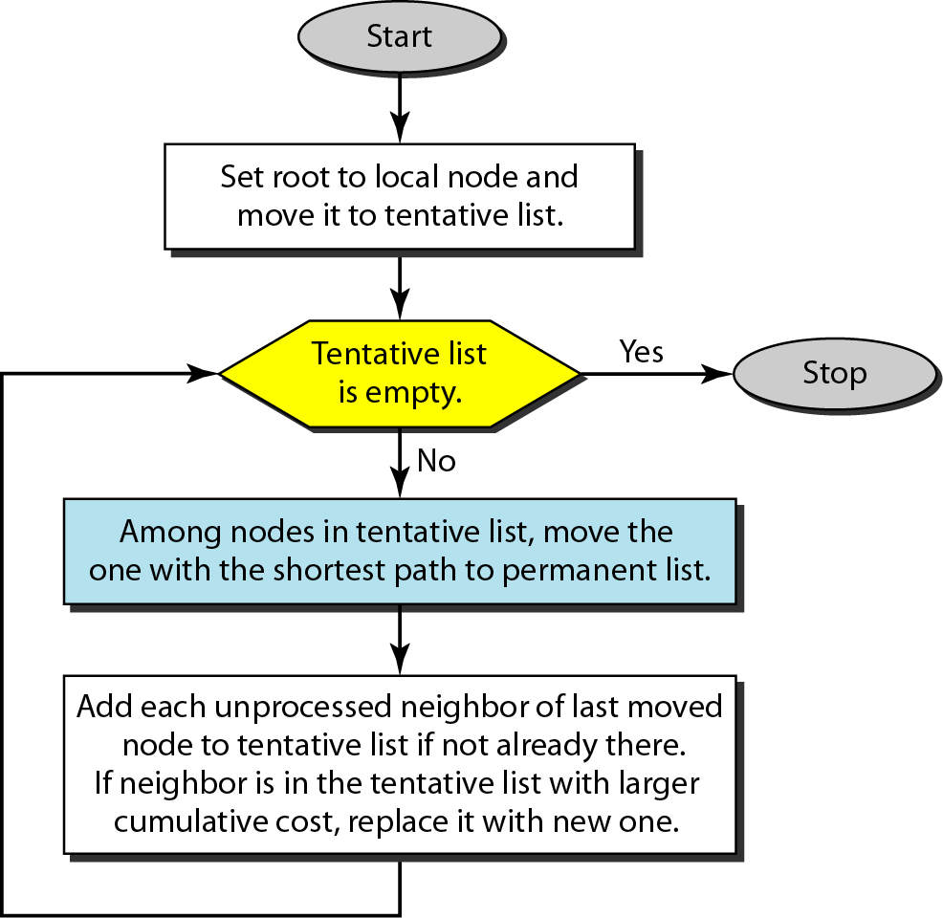
Dijkstra algorithm

Slide 66
Shortest Path Routing
Dijkstra’s Algorithm
What does it mean to be the shortest (or optimal) route?
Choices:
Minimize the number of hops along the path.
Minimize mean packet delay.
Maximize the network throughput.

Slide 67
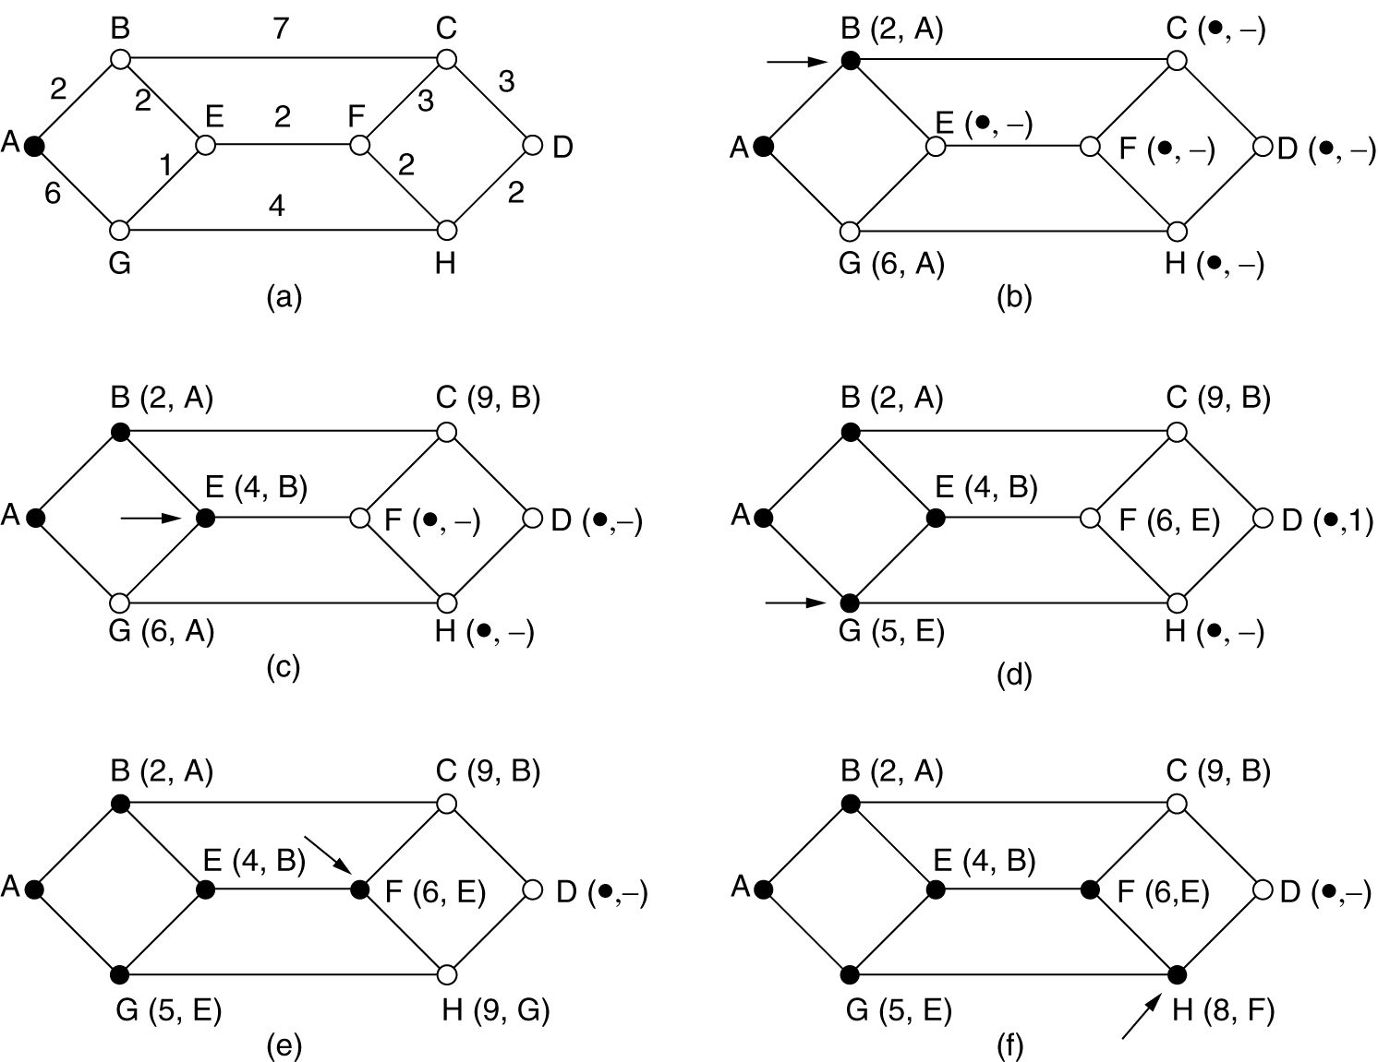
Dijkstra’s Algorithm Shortest Path Routing
The first 5 steps used in computing the shortest path from A to D. The arrows indicate the working node.

Slide 68
The steps used in computing the shortest path from A to D. The arrows indicate the working node – permanent label.
The cost can relates to delay
Start search and compare with tentative label
Mark permanent when shortest node found
Once permanent never changed
Tentative node can always be search and relabelled
Tentative label change
The label on each node can be TENTATIVE or PERMANENT

Slide 69
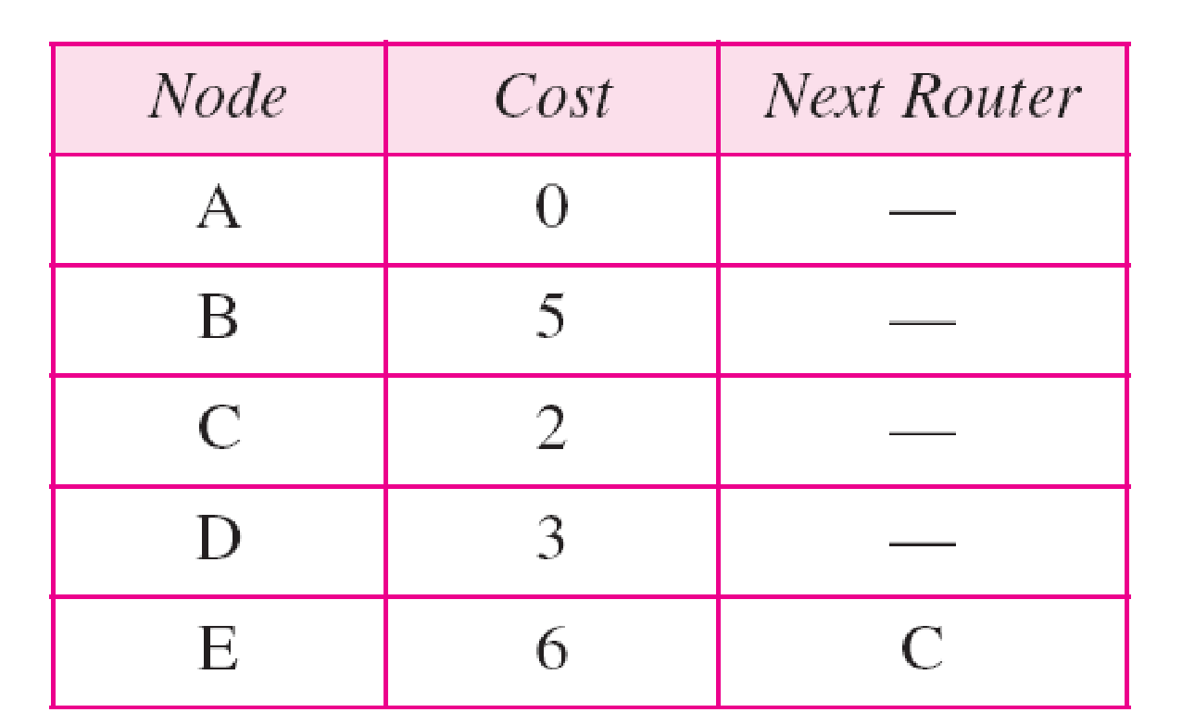
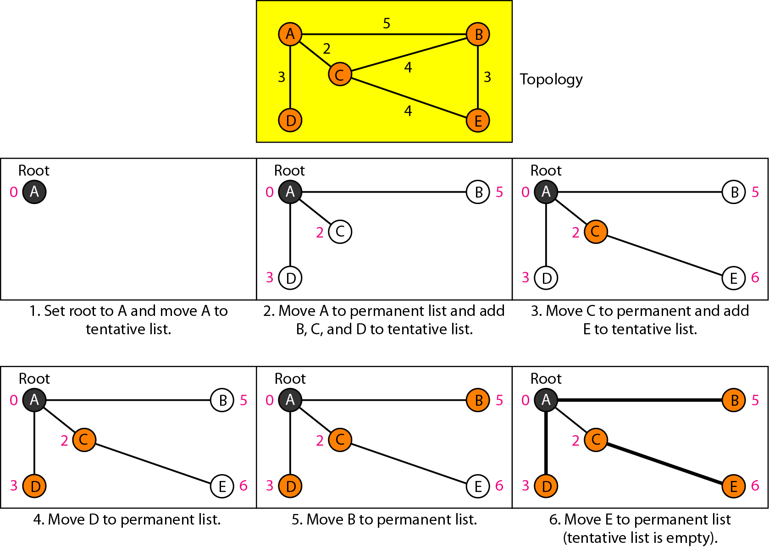
Example of formation of shortest path tree

Slide 70
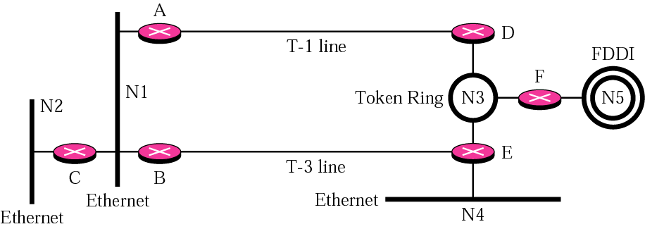
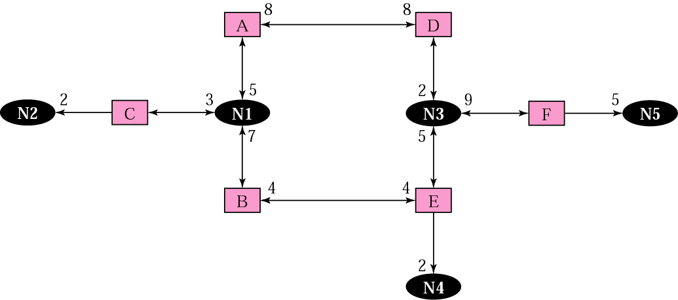
Example of an internet
Graphical representation of an internet
8
5
2
2
0
0
5
0
4
4
2

Slide 71
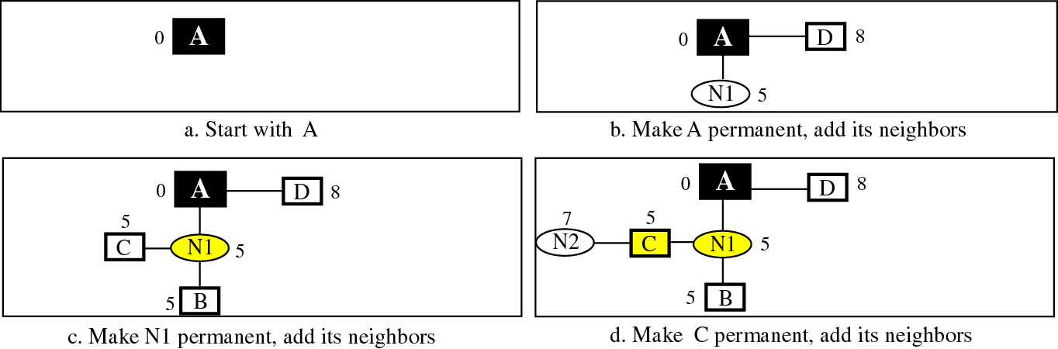
Shortest path calculation
8
5
2
2
0
0
5
0
4
4
2

Slide 72
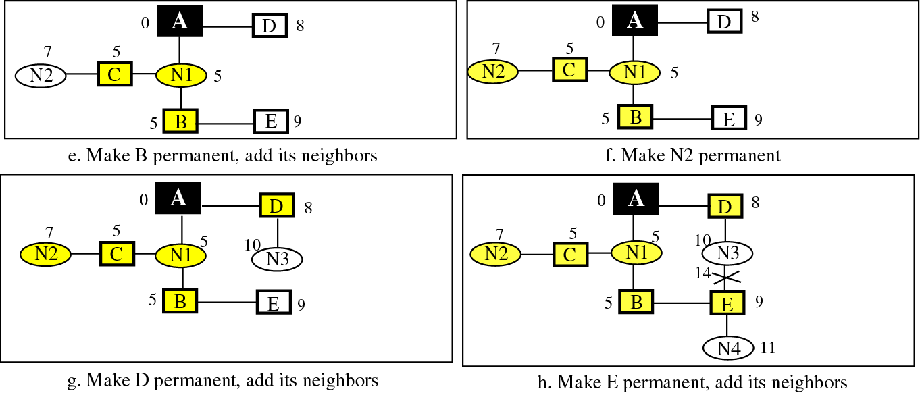
Shortest path calculation
14
8
5
2
2
0
0
5
0
4
4
2

Slide 73
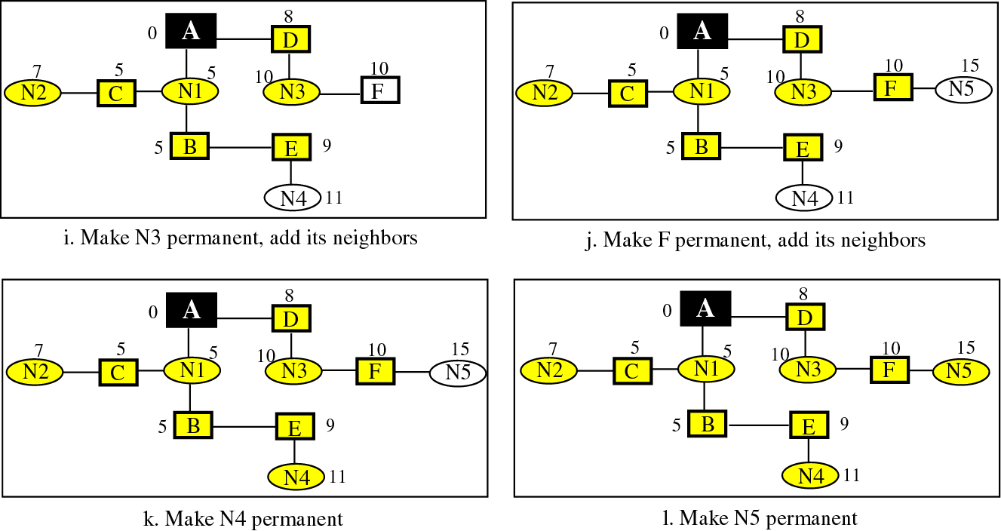
Shortest path calculation
8
5
2
2
0
0
5
0
4
4
2

Slide 74
Link state routing table for router A
Each router uses the shortest-path tree method to construct its routing table.
Network | Cost | Next router | Other infor
N1 | 5
N2 | 7 | C
N3 | 10 | D
N4 | 11 | B
N5 | 15 | D

Slide 75
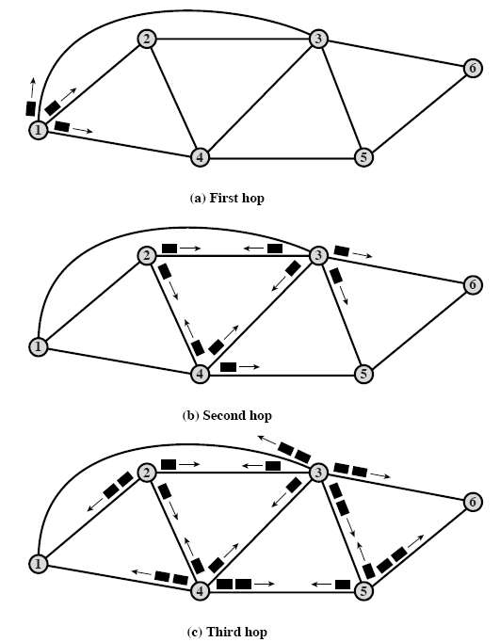
Flooding
Every incoming packet forwarded on every outgoing link except the one it arrived on.
Problem: duplicates.
Constraining the flood:
Hop count.
Keep track of packets that have been flooded.
Robust, shortest delay (picks shortest path as one of the paths).

Slide 76
Internetwork Routing
Adaptive Routing
Centralized
Distributed
Isolated
[IGP]
Intradomain routing
[EGP]
Interdomain routing
Interior
Gateway Protocols
[BGP,IDRP]
Exterior
Gateway Protocols
Distance Vector routing
Link State routing
[RIP]
[OSPF,IS-IS,PNNI]

Slide 77
Adaptive Routing
Basic functions:
Measurement of pertinent network data.
Forwarding of information to where the routing computation will be done.
Compute the routing tables.
Convert the routing table information into a routing decision and then dispatch the data packet.

Slide 78
Distance Vector Routing
Historically known as the old ARPANET routing algorithm {or known as Bellman-Ford algorithm}.
Basic idea: each network node maintains a Distance Vector table containing the distance between itself and ALL possible destination nodes.
Distances are based on a chosen metric and are computed using information from the neighbors’ distance vectors.
Metric: usually hops or delay

Slide 79
Distance Vector Routing (DVR)
3 keys to understand how this algorithm works:
Sharing knowledge about the entire AS. Each router shares its knowledge about the entire AS with neighbours. It sends whatever it has.
Sharing only with immediate neighbours. Each router sends whatever knowledge it has thru all its interface.
Sharing at regular intervals. sends at fixed intervals, e.g. every 30 sec.
Problems: Tedious comparing/updating process, slow response to infinite loop problem, huge list to be maintained!!

Slide 80
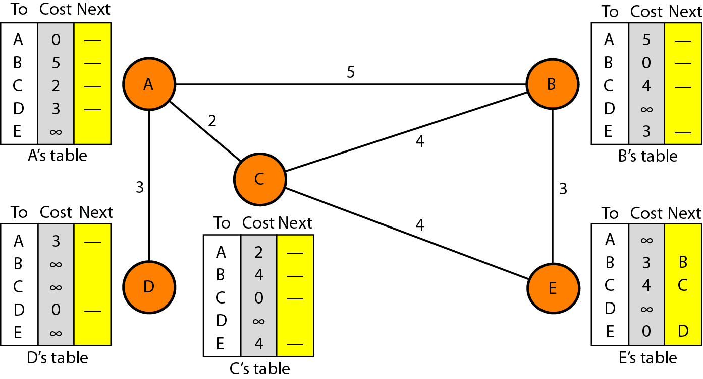
Initialization of tables in distance vector routing (DVR)

Slide 81
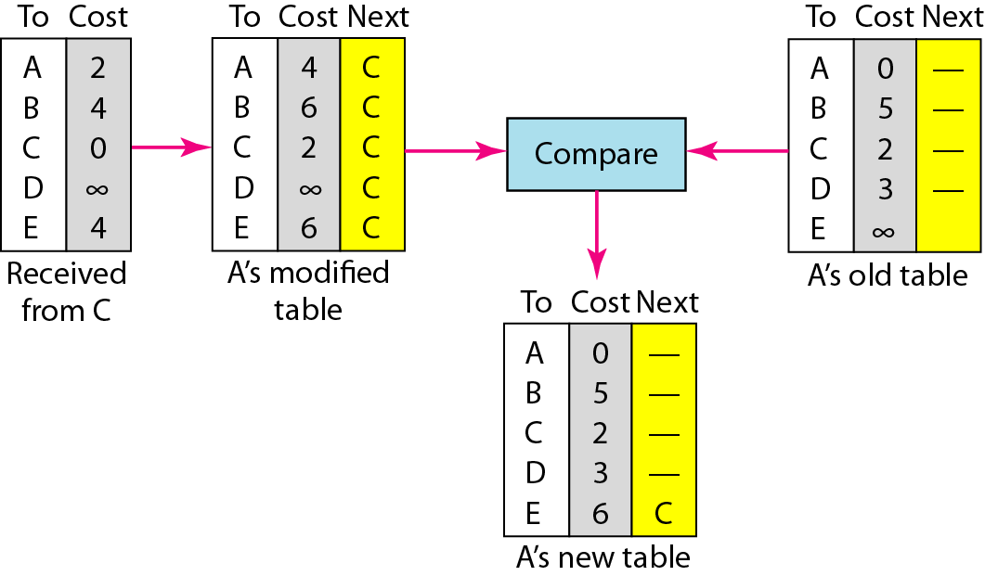
Updating in distance vector routing example: C to A
From C
From A
A to A via C: ACA = AC+ CA = 2+2
A to B via C: ACB = AC + CB = 2+4
A to D via C: ACD = AC + CD = 2 + ∞
A to E via C: ACE = AC + CE = 2+4
A to C via C: ACC = AC + CC = 2+0

Slide 82
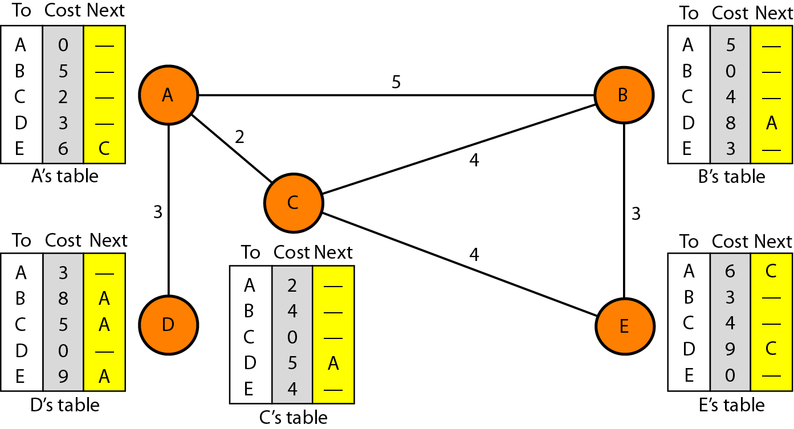
Final Distance vector routing tables

Slide 83
Distance Vector Routing
Information kept by DV router
each router has an ID
associated with each link connected to a router, there is a link cost (static or dynamic) the metric issue!
Distance Vector Table Initialization
Distance to itself = 0
Distance to ALL other routers = infinity number

Slide 84
Distance Vector Algorithm
Router transmits its distance vector to each of its neighbors.
Each router receives and saves the most recently received distance vector from each of its neighbors.
A router recalculates its distance vector when:
It receives a distance vector from a neighbor containing different information than before.
It discovers that a link to a neighbor has gone down (i.e., a topology change).
The DV calculation is based on minimizing the cost to each destination.

Slide 85
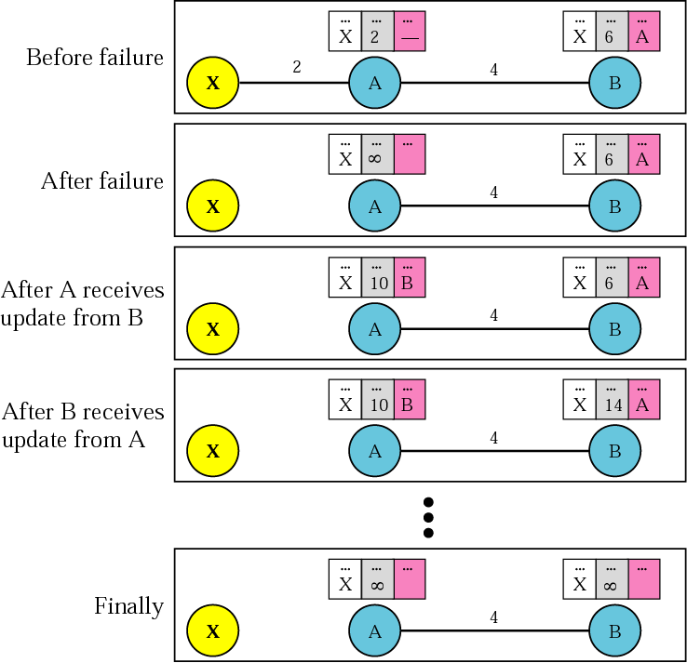
Figure 14.6 Two-node instability

Slide 86
Count to ∞

Slide 87
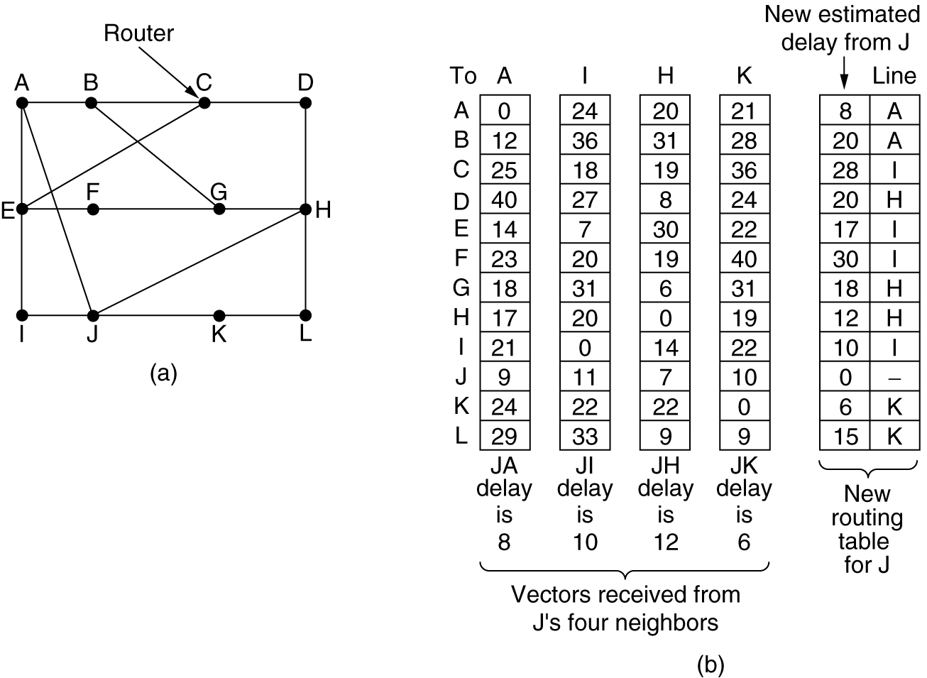
Distance Vector Routing
.(a) A subnet. (b) Input from A, I, H, K, and the new routing table for J.

Slide 88
Link State Algorithm
Each router must do the following:
Discover its neighbors, learn their network address.
Measure the delay or cost to each of its neighbors.
Construct a packet telling all it has just learned.
Send this packet to all other routers.
Compute the shortest path to every other router.

Slide 89
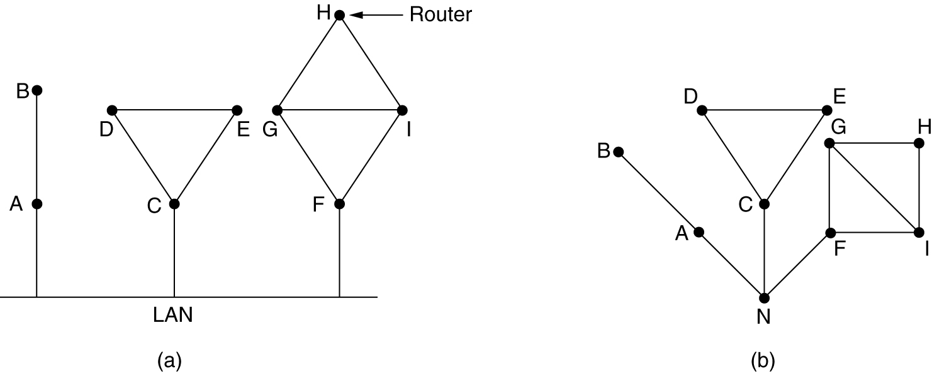
Learning about the Neighbors
(a) Nine routers and a LAN. (b) A graph model of (a).

Slide 90
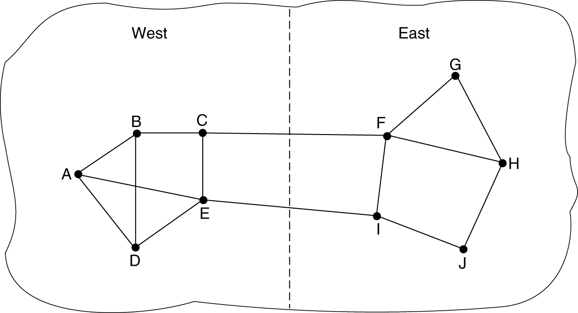
Measuring Line Cost
A subnet in which the East and West parts are connected by two lines.

Slide 91

Building Link State Packets
(a) A subnet. (b) The link state packets for this subnet.

Slide 92

Distributing the Link State Packets
The packet buffer for router B in the previous slide

Slide 93
Routing Information Protocol (RIP)
A simple intra domain protocol
Straightforward implementation of Distance Vector Routing
Each router advertises its distance vector every 30 seconds (or whenever its routing table changes) to all of its neighbors
RIP always uses 1 as link metric
Maximum hop count is 15, with “16” equal to “∞”
Routes are timeout (set to 16) after 3 minutes if they are not updated

Slide 94
RIPv2
RIPv2 is an extends RIPv1:
Subnet masks are carried in the route information
Authentication of routing messages
Route information carries next-hop address
Exploites IP multicasting
Extensions of RIPv2 are carried in unused fields of RIPv1 messages

Slide 95
RIP Messages
This is the operation of RIP in routed. Dedicated port for RIP is UDP port 520.
Two types of messages:
Request messages
used to ask neighboring nodes for an update
Response messages
contains an update

Slide 96
Routing with RIP
Initialization: Send a request packet (command = 1, address family=0..0) on all interfaces:
RIPv1 uses broadcast if possible,
RIPv2 uses multicast address 224.0.0.9, if possible
requesting routing tables from neighboring routers
Request received: Routers that receive above request send their entire routing table
Response received: Update the routing table
Typically, there is a routing daemon (routed) that is an application layer process that provides access to routing tables.

Slide 97
Routing with Rip Cont.
Regular routing updates: Every 30 seconds, send all or part of the routing tables to every neighbor in an response message
Triggered Updates: Whenever the metric for a route change, send entire routing table.
If a router does not hear from its neighbor once every 180 seconds, the neighbor is deemed unreachable.

Slide 98
Security
Issue: Sending bogus routing updates to a router
RIPv1: No protection
RIPv2: Simple authentication scheme

Slide 99
RIP Problems
RIP takes a long time to stabilize
Even for a small network, it takes several minutes until the routing tables have settled after a change
The maximum path in RIP is 15 hops

Slide 100
Open Shortest Path First(OSPF)
Provides for authentication of routing messages.
8-byte password designed to avoid misconfiguration.
Provides additional hierarchy
Domains are partitioned into areas.
This reduces the amount of information transmitted in packet.
Provides load-balancing via multiple routes.

Slide 101
Open Shortest Path First (OSPF)
OSPF runs on top of IP, i.e., an OSPF packet is transmitted with IP data packet header.
Uses Level 1 and Level 2 routers
Has: backbone routers, area border routers, and AS boundary routers

Slide 102

OSPF—An Interior Gateway Routing Protocol (1)
An autonomous system

Slide 103

OSPF—An Interior Gateway Routing Protocol (2)
A graph representation of the previous slide.

Slide 104

OSPF—An Interior Gateway Routing Protocol (3)
The relation between ASes, backbones, and areas in OSPF.

Slide 105
OSPF Terminology
Internal router :: a level 1 router.
Backbone router :: a level 2 router.
Area border router (ABR) :: a backbone router that attaches to more than one area.
AS border router :: (an interdomain router), namely, a router that attaches to routers from other ASs across AS boundaries.

Slide 106

OSPF—An Interior Gateway Routing Protocol (4)
The five types of OSPF messages

Slide 107

OSPF
The relation between ASes, backbones, and areas in OSPF.

Slide 108
Border Gateway Protocol (BGP)
The replacement for EGP is BGP. Current version is BGP-4.
BGP assumes the Internet is an arbitrary interconnected set of AS’s.
In interdomain routing the goal is to find ANY path to the intended destination that is loop-free. The protocols are more concerned with reachability than optimality.

Slide 109

BGP—The Exterior Gateway Routing Protocol (2)
Routing policies between four Autonomous Systems

Slide 110

BGP—The Exterior Gateway Routing Protocol (3)
Propagation of BGP route advertisements

Slide 111
Congestion Control Algorithms
General Principles of Congestion Control
Congestion Prevention Policies
Congestion Control in Virtual-Circuit Subnets
Congestion Control in Datagram Subnets
Load Shedding
Jitter Control

Slide 112
Congestion Control
Too many packets present in (a part of) the network causes packet delay and loss that degrades performance. This situation is called congestion.
Since congestion occurs within the network, it is the network layer that directly experiences it and must ultimately determine what to do with the excess packets.
The network and transport layers share the responsibility for handling congestion.
Congestion at the network layer is related to two issues, throughput and delay.

Slide 113

Congestion
When too much traffic is offered, congestion sets in and performance degrades sharply.

Slide 114
Congestion control refers to techniques and mechanisms that can either prevent congestion before it happens or remove congestion after it has happened.
-The difference between flow control and congestion control is that Flow control, in contrast, relates to the traffic between a particular sender and a particular receiver.
Its job is to make sure that a fast sender cannot continually transmit data faster than the receiver is able to absorb it and Congestion control has to do with making sure the network is able to carry the offered traffic.
It is a global issue, involving the behavior of all the hosts and routers.
We can divide congestion control mechanisms into two broad categories: open-loop congestion control (prevention)and closed-loop congestion control (removal).

Slide 115
Open-Loop Congestion Control:
In open-loop congestion control, policies are applied to prevent congestion before it happens.
In these mechanisms, congestion control is handled by either the source or the destination.
There is a brief list of policies that can prevent congestion.
Retransmission Policy: Retransmission is sometimes unavoidable. If the sender feels that a sent packet is lost or corrupted, the packet needs to be retransmitted.
Retransmission in general may increase congestion in the network.
However, a good retransmission policy can prevent congestion.
The retransmission policy and the retransmission timers must be designed to optimize efficiency and at the same time prevent congestion

Slide 116
Open-Loop Congestion Control (Cntd.):
Window Policy: The type of window at the sender may also affect congestion. The Selective Repeat window is better than the Go-Back-N window for congestion control.
In the Go-Back-N window, when the timer for a packet times out, several packets may be resent, although some may have arrived safe and sound at the receiver.
This duplication may make the congestion worse. The Selective Repeat window, on the other hand, tries to send the specific packets that have been lost or corrupted.
Acknowledgment Policy: The acknowledgment policy imposed by the receiver may also affect congestion.
If the receiver does not acknowledge every packet it receives, it may slow down the sender and help prevent congestion.
Several approaches are used in this case. A receiver may send an acknowledgment only if it has a packet to be sent or a special timer expires. A receiver may decide to acknowledge only N packets at a time. We need to know that the acknowledgments are also part of the load in a network. Sending fewer acknowledgments means imposing less load on the network.

Slide 117
Open-Loop Congestion Control (Cntd.):
Discarding Policy: A good discarding policy by the routers may prevent congestion and at the same time may not harm the integrity of the transmission. For example, in audio transmission, if the policy is to discard less sensitive packets when congestion is likely to happen, the quality of sound is still preserved and congestion is prevented or alleviated.
Admission Policy: An admission policy, which is a quality-of-service mechanism, can also prevent congestion in virtual-circuit networks. Switches in a flow first check the resource requirement of a flow before admitting it to the network. A router can deny establishing a virtual-circuit connection if there is congestion in the network or if there is a possibility of future congestion

Slide 118
Closed-Loop Congestion Control:
Closed-loop congestion control mechanisms try to alleviate congestion after it happens.
Several mechanisms have been used by different protocols. We describe a few of them here.
Backpressure: The technique of backpressure refers to a congestion control mechanism in which a congested node stops receiving data from the immediate upstream node or nodes. This may cause the upstream node or no des to become congested, and they, in turn, reject data from their upstream node or nodes, and so on.
Backpressure is a node-to-node congestion control that starts with a node and propagates, in the opposite direction of data flow, to the source.
The backpressure technique can be applied only to virtual circuit networks, in which each node knows the upstream node from which a flow of data is coming.
Following figure shows the idea of backpressure.

Slide 119

Closed-Loop Congestion Control (Cntd.):
Figure: Backpressure method for alleviating congestion

Slide 120

Closed-Loop Congestion Control (Cntd.):
A choke packet is a packet sent by a node to the source to inform it of congestion.
Note the difference in backpressure, the warning is from one node to its upstream node, although the warning may eventually reach the source station.
In the choke-packet method, the warning is from the router, which has encountered congestion, directly to the source station. The intermediate nodes through which the packet has travelled are not warned.

Slide 121
Closed-Loop Congestion Control (Cntd.):
Implicit Signalling:
In implicit signalling, there is no communication between the congested node or nodes and the source. The source guesses that there is congestionsomewhere in the network from other symptoms.
▪For example, when a source sends several packets and there is no acknowledgment for a while, one assumption is that the network is congested. The delay in receiving an acknowledgment is interpreted as congestionin the network; the source should slow down. (Can be seen in TCP Congestion control)
Explicit Signalling:
The node that experiences congestion can explicitly send a signal to the source or destination.
The explicit-signalling method, however, is different from the choke-packet method. In the choke-packet method, a separate packet is used for this purpose; in the explicit-signallingmethod, the signal is included in the packets that carry data.
Explicit signalling can occur in either the forward or the backward direction. (Can be seen in ATM network)

Slide 122
General Principles of Congestion Control
Monitor the system .
detect when and where congestion occurs.
Pass information to where action can be taken.
Adjust system operation to correct the problem.

Slide 123

Congestion Prevention Policies
Policies that affect congestion.
5-26

Slide 124
Congestion Control in Virtual-Circuit Subnets
(a) A congested subnet. (b) A redrawn subnet, eliminates congestion and a virtual circuit from A to B.

Slide 125

Hop-by-Hop Choke Packets
(a) A choke packet that affects only the source.
(b) A choke packet that affects each hop it passes through.

Slide 126
Jitter Control
(a) High jitter. (b) Low jitter.

Slide 127
TCP Congestion Control Algorithms
The Leaky Bucket Algorithm
The Token Bucket Algorithm

Slide 128

The Leaky Bucket Algorithm
(a) A leaky bucket with water. (b) a leaky bucket with packets.

Slide 129

The Token Bucket Algorithm
5-34
(a) Before. (b) After.

Slide 130

Admission Control
An example of flow specification.
5-34

Slide 131

Packet Scheduling
(a) A router with five packets queued for line O.
(b) Finishing times for the five packets.

Slide 132

RSVP-The ReSerVation Protocol
(a) A network, (b) The multicast spanning tree for host 1. (c) The multicast spanning tree for host 2.

Slide 133

RSVP-The ReSerVation Protocol (2)
(a) Host 3 requests a channel to host 1. (b) Host 3 then requests a second channel, to host 2. (c) Host 5 requests a channel to host 1.

Slide 134

Expedited Forwarding
Expedited packets experience a traffic-free network.

Slide 135

Assured Forwarding
A possible implementation of the data flow for assured forwarding.

Slide 136

Label Switching and MPLS
Transmitting a TCP segment using IP, MPLS, and PPP.

Slide 137
What are the different classes of IP address? Explain the concept private IP addresses. Where and why the NAT is used?
What is routing? Explain the difference between link state routing and distance vector routing
Consider any class-B network with default subnet mask. How many actual hosts can be connected in that network?
Divide that network into 8 equal subnets?
What is the new subnet mask?
What is the starting address of the 4th Subnet?
What is the last address of the 4e Subnet?
How many hosts can be connected in each subnet? (Give all details).
Explain IP With header format
Write a shot Note on
Count to infinity problem
Flooding
Selective Flooding
NAT
Subnatting

Slide 138
Difference between datagram and virtual circuit
Explain stepwise the procedure carried out by DHCP client and DHCP Server. Draw diagrams showing the above communication
Explain in details Adaptive and Non Adaptive Algorithms
For a any given class B network with default subnet mask, how many host can be accommodated I each network. How can you divide into 4 equals subnet? How many hosts can be accommodated in each sub-network?
Explain in details IPV4 and IPV6(With Formate)
Difference between leaky bucket and token bucket algorithm
What are the Private IP range

